Slide 1
Time Series Forecasting Beginner Training Session
Viraj Bhambri
Senior Analyst, LatentView Analytics

Slide 2
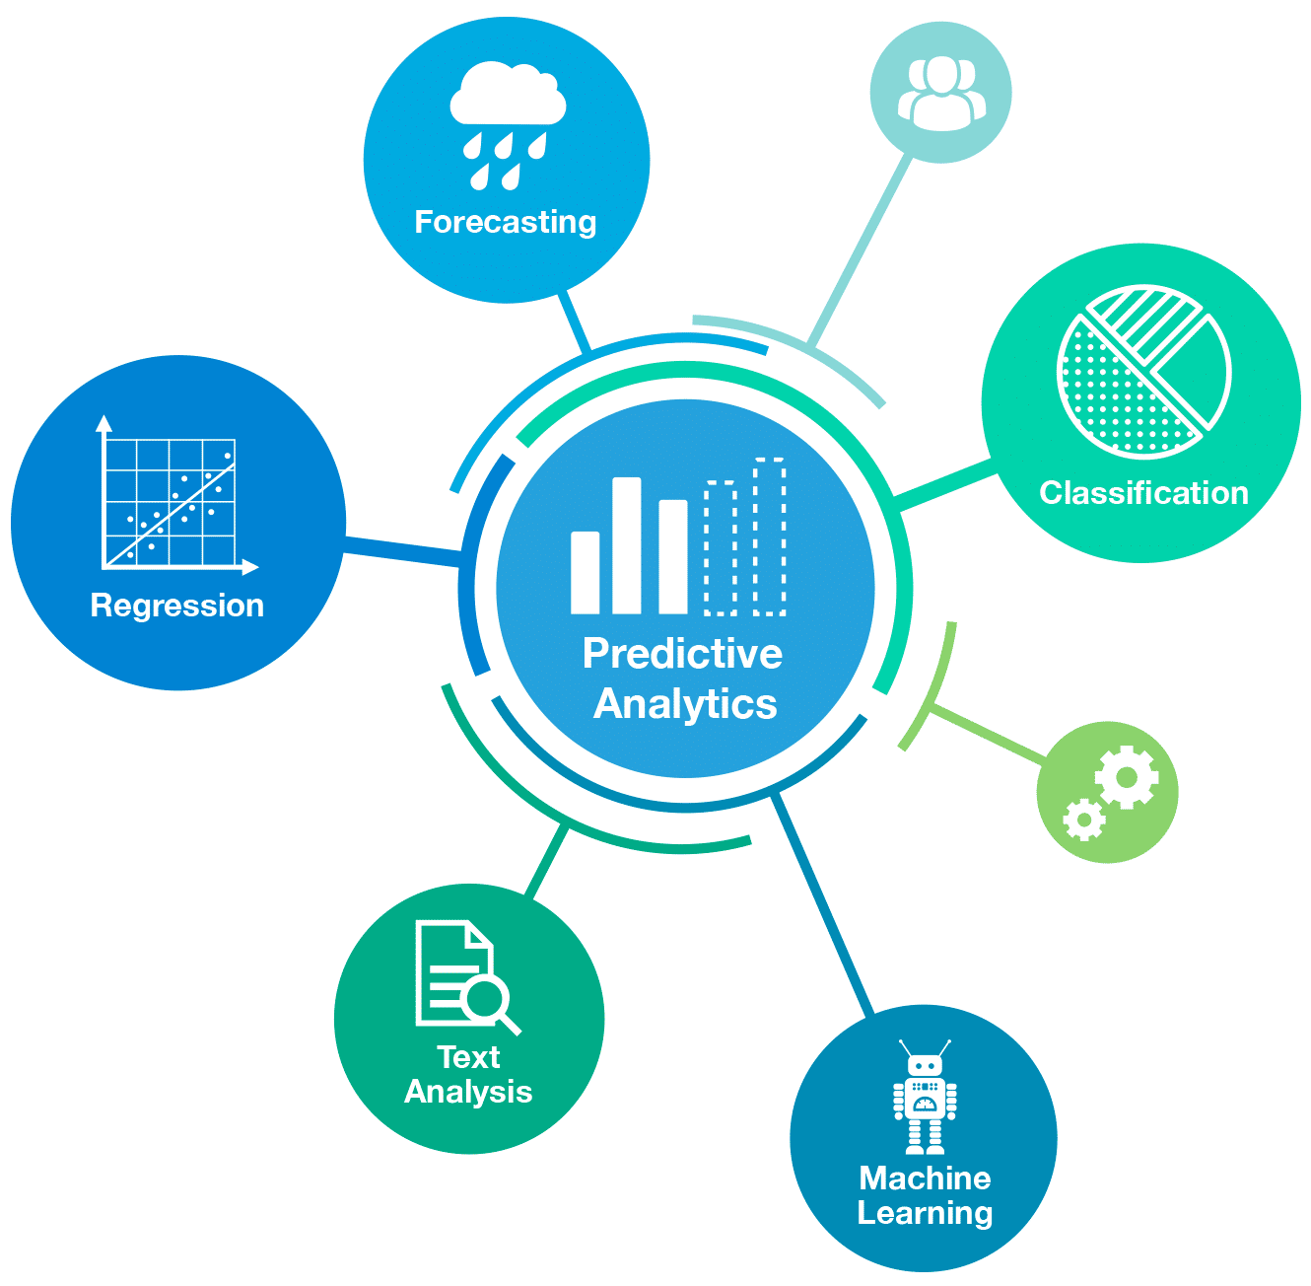
Intro to Predictive Analytics - Forecasting Focus
Application of Forecasting:
Manufacturing
Retail
Service
Website Traffic
Weather Forecast
Period for which forecast is required:
Short Term Forecast | Long Term Forecast
Daily/Weekly/Monthly Horizon | Single/Multi-Year Horizon
SKU/Product Level | Aggregated Level
Inexpensive and quick | Expensive and Time Consuming
For Short Term Planning | Deals with comprehensive Issues
Usually More Accurate | Less Accurate

Slide 3
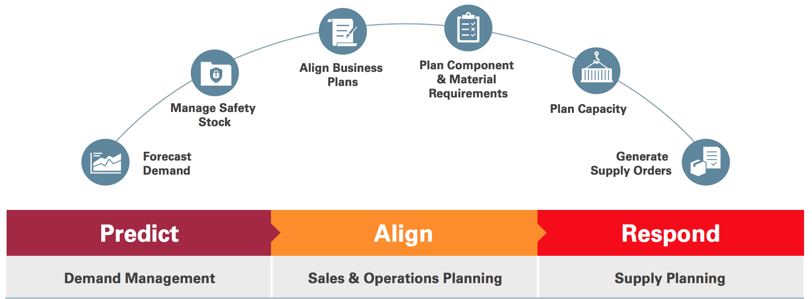
Role of Forecasting
Demand forecasts form the basis of all planning decisions in a supply chain
Push: produce to anticipated demand levels
Pull: set capacity and component availability levels

Slide 4
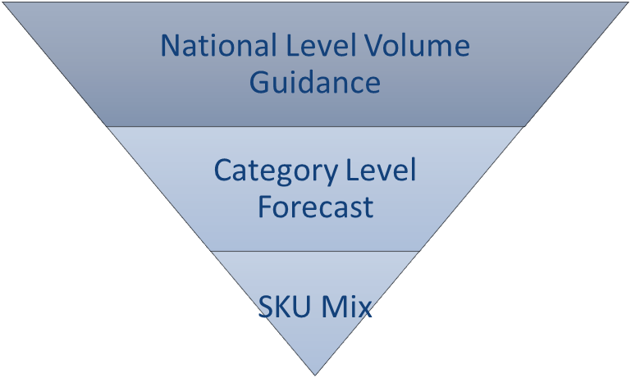
Methodology
Basic Steps:
Problem Definition
Gathering Information - What all can impact the forecast - Judgement Aspect
Preliminary Analysis - Lookout for consistent patterns - Trends & Seasonality
Choosing and fitting the model - Regression, Smoothing, ARIMA, Hierarchical - Baseline
Using and evaluating a forecasting model
Define Problem
Gather Information
Exploratory Analysis
Fit the Model
Evaluate
Questions to be answered:
What level you need to forecast at?
Depends on the goals & plans set by the business
How many warehouses are there
Use a Top-Down or Bottom-Up approach the validate the numbers
For what period in future do you need to forecast for?
From where items are shipped from and how frequently?
What other aspects goes into production planning.
Sourcing of Raw Materials

Slide 5
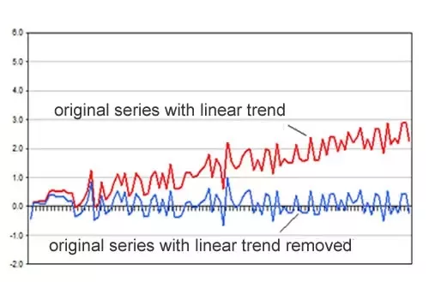
Basics of Time Series
Time series is a series of data elements which is indexed and time-stamped :
The sequence of elements is important and should be maintained for any analysis
It is measured at consistent time intervals and has no Missing Values.
Example: Weather data, Stock prices, Industry forecasts, etc
Frequency: the number of observations in a series if you consider the natural time interval of measurement
A time series is said to be stationary if:
The mean value of time-series is constant over time, which implies, the trend component is nullified.
The variance does not increase over time.
Seasonality effect is minimal.
White Noise(ϵt): A Time series, with no auto-correlation. Series is weakly stationary.
Drift: the amount of change over time (called the drift) is set to be the average change seen in the historical data
Data | Frequency
Annual | 1
Quarterly | 4
Monthly | 12
Weekly | 52
Credit: Rob J Hyndman – Forecasting Principles and Practice
Fig: Series with & without Linear Trend
Notes:
Backward shift or lag operator(B): It takes a time series element as an argument and returns the element one time unit previously. B x_{t}=x_{t−1}
Difference operator(∇) : It takes a time series element as an argument and returns the difference between the element and that of one time unit previously. ∇x _{t} =x_{t}−x_{t−1}

Slide 6
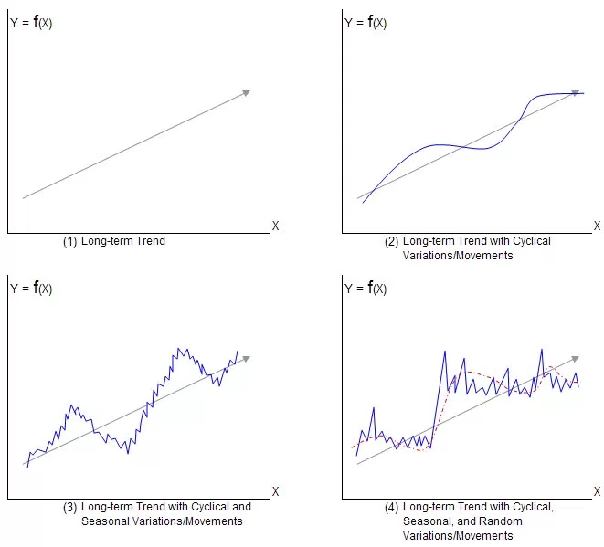
Types of Time Series
Following are the types of time series based on their patterns.
Trend :A trend exists when there is a long-term increase or decrease in the data. It does not have to be linear. Trend is “changing direction” when it might go from an increasing trend to a decreasing trend.
Ex: Mobile Phone Sales, Population growth, Electricity usage might follow Trend component
Seasonal : A seasonal pattern exists when a series is influenced by seasonal factors (e.g., the quarter of the year, the month, or day of the week). Seasonality is always of a fixed and known period also called as Periodic.
Ex: Retail Industry
Cyclic : A cyclic pattern exists when data exhibit rises and falls that are not of fixed period. The duration of these fluctuations is usually of at least 2 years.
Ex: Airline Industry,
Noise: The random variation in the series.
Credit: Rob J Hyndman – Forecasting Principles and Practice

Slide 7
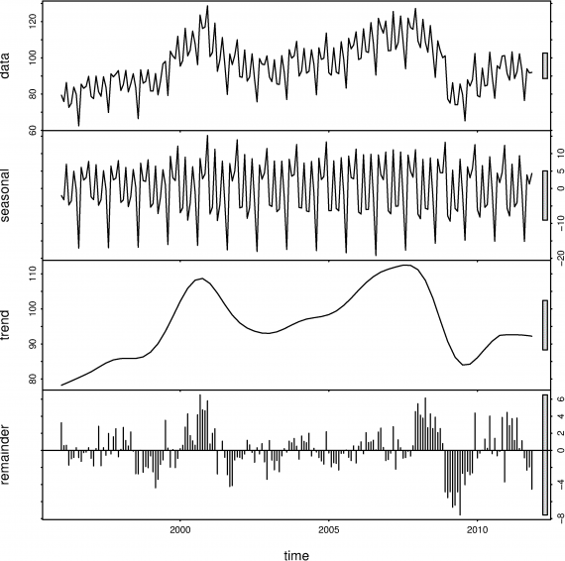
Time Series Decomposition
Based on the combination of the components, two models evolved. They are:
Additive Model: An additive model is linear where changes over time are consistently made by the same amount.
y(t) = Level + Trend + Seasonality + Noise
Multiplicative model: A multiplicative model is nonlinear, such as quadratic or exponential. Changes increase or decrease over time
y(t) = Level * Trend * Seasonality * Noise
The process of extracting Trend, Seasonal & Remainder components is referred to as decomposition. In R (STL) is a function that help obtain the different time series components.
Decomposition(data)=Trend +Seasonal +Remainder
Credit: Rob J Hyndman – Forecasting Principles and Practice

Slide 8
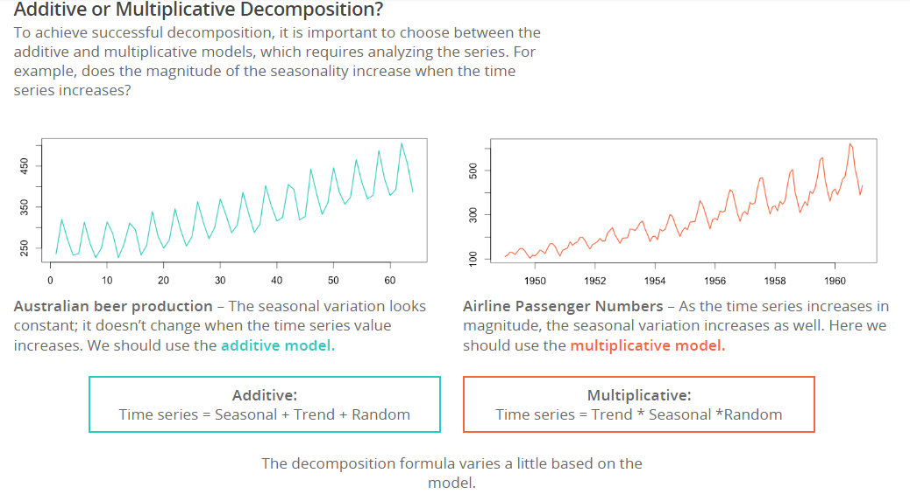
Additive & Multiplicative Series
Credit: Rob J Hyndman – Forecasting Principles and Practice
Notes:
Credit Image

Slide 9
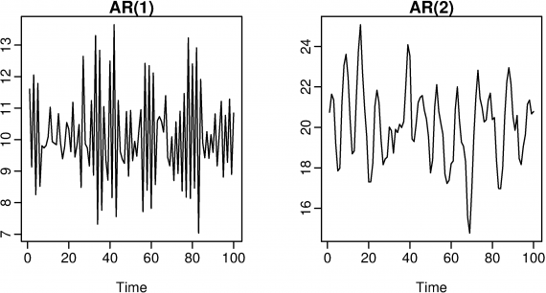
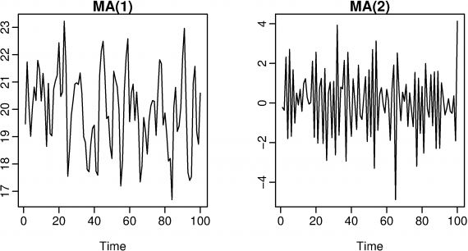
ARIMA Components
ARIMA models aim to describe the autocorrelations in the data, has two components AR & MA.
Autoregressive models(AR):In AR Model ,forecasting the variable of interest using a linear combination of past values of the variable. The term auto regression indicates that it is a regression of the variable against itself.
y _{t} =c+ϕ₁y_{t−1}+ ϕ₂y_{t−2}+⋯+ϕ_{p} y_{t−p} +e_{t}
where c is a constant and e_{t} is white noise. This is like a multiple regression but with lagged values of y_{t} as predictors.
Moving average models(MA): Moving average model uses past forecast errors in a regression-like model.
y_{t}= c+ e_{t}+θ₁e_{t−1}+θ₂e_{t−2}+⋯+θ_{q} e_{t−q}
A moving average model is used for forecasting future values while moving average smoothing is used for estimating the trend-cycle of past values.
Credit: Rob J Hyndman – Forecasting Principles and Practice
Notes:
Credit:

Slide 10
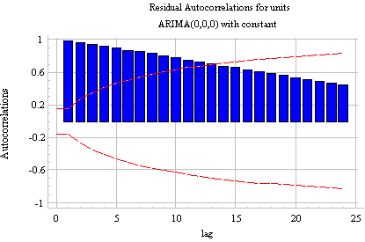
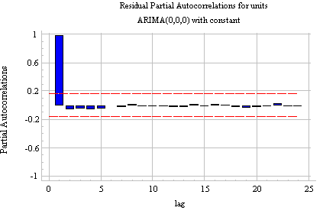
ACF and PACF Plots
To determine the appropriate values for p and q ACF & PACF plots are used.
ACF: The autocorrelation function (ACF) plot shows the correlation of the series with itself at different lags
PACF : It is the amount of correlation between a variable and a lag of itself that is not explained by correlations at all lower-order-lags.
Ex: The autocorrelations(ACF) are significant for a large number of lags-spike at Lag1.The same is confirmed from PACF, plot has a significant spike only at lag 1
Credit: Rob J Hyndman – Forecasting Principles and Practice

Slide 11
Configuration & Exploratory Analysis Flow
No Missing Value
Missing Values
Data Capture:
Imputation using Suitable Technique
Import & Sort in ascending order of time
Check for missing values for every series
Investigate the Reasons
Aggregate the Data to Required Level of Analysis
Add Blank Row and Impute Zero
Treat Outlier after Investigation
Train Model & Check Accuracy on OOT Window
Apply Seasonal &Trend Decomposition of Series: Identify Outliers
Identify type of TS: Additive/Multiplicative
Split Series for Model Building: In-time & OOT
Plot Seasonal & Line charts to Identify Outliers
Configure Time series
Identify Suitable Transformation For Series
Check For Stationarity of Series

Slide 12
Forecasting Techniques
STLF
Features
Forecast can be generated for:
Additive: No Data transformations
Multiplicative: Log Transformation to transform additive to multiplicative series
Robust to outliers
Decomposed series can be forecasted using EMA (default), ARIMA, Naïve, and Random Walk
Requirements:
Needs more than 2 Periods of Data
Suitable for Non-Stationary data
Limitations:
Cannot handle to calendar variation due to reliance on seasonality periods.
Cannot handle multiple seasonality.
Exponential Smoothening
SES
Requirement:
Series should be Stationary
There should be no Trend and Seasonality
Limitation
Basic Technique useful for imputation & baseline forecast
Double or Holt
Requirements:
Series could be Stationary or non-Stationary
Series should have linear/ exponential trend
No Seasonality.
Features: Dampening Can be provided
Triple or Holt Winter
Requirement:
Series can have Trend & Seasonality. Stationary and Non-Stationary Series
Features:
Dampening can be provided
Both Additive & Multiplicative can be handled
Limitations: ETS requires less than 2 Periods of data

Slide 13
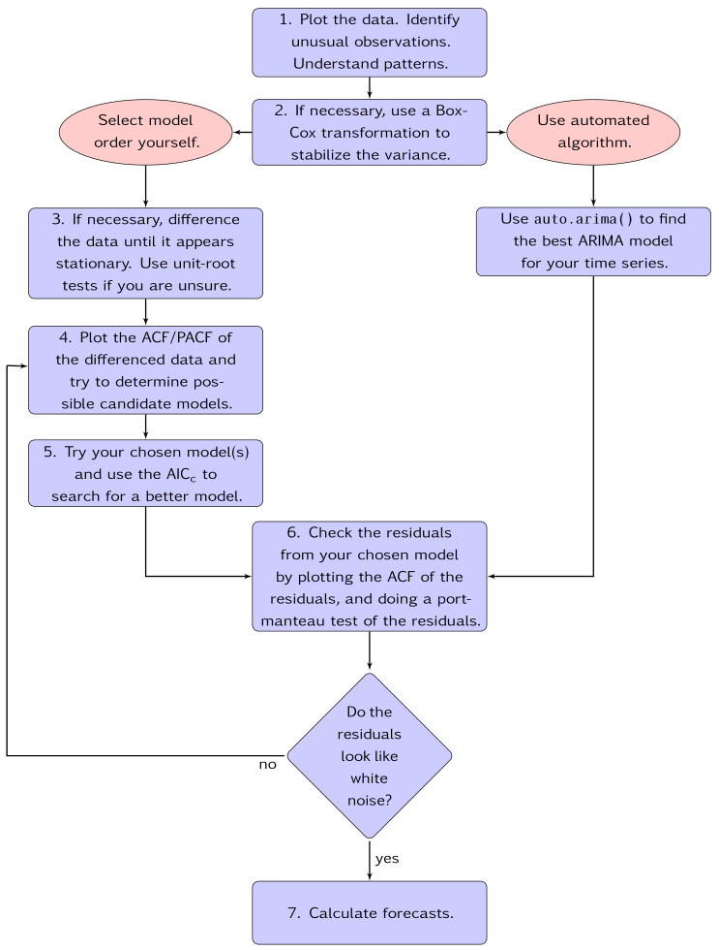
Forecasting Techniques
ARIMA
Requirements:
Requires Series to be Stationary
Differencing to be performed to remove trend
Seasonality to be removed by use of Seasonal differencing/De-Seasonalizing
Features
Describes the autocorrelations in the data
Has two components:
Autoregressive: forecasting a linear combination of past values of the variable. Indicates that it is a regression of the variable against itself to identify patterns
Moving Average: Uses past forecast errors in a regression-like model.
Re-Integrates the data to obtain forecasts on differenced values
Advanced:
Seasonal ARIMA can also be performed
ARIMAX: External Regressors can be provided for fitting the error term/Residuals
Credit: Rob J Hyndman – Forecasting Principles and Practice

Slide 14
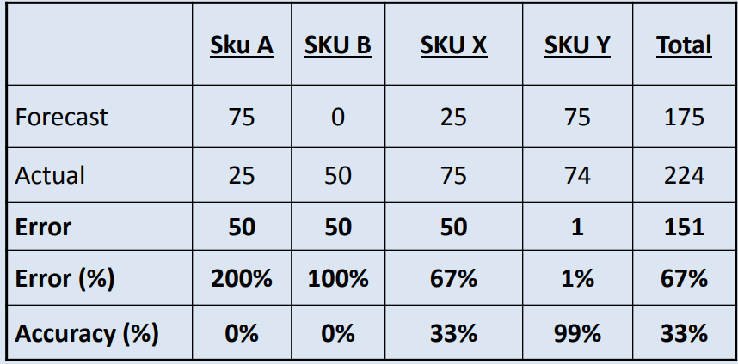
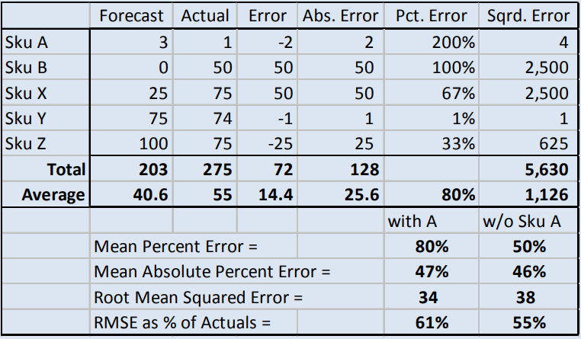
Forecast Accuracy Methods
Generation of accurate Forecast is critical for Proper allocation of Supply chain Resources
Forecast error=abs(Actual-Forecast)
Error(%)=|A-F|/A
Accuracy(%)=1-Error(%)
Performance metric to measure forecast Accuracy is MAPE
MAPE=∑|A-F|/∑A

Slide 15
Course Repository
Topics | Repository
Time Series Objects-Characteristics/Frequency/Stationarity/Seasonality | http://r-statistics.co/Time-Series-Analysis-With-R.html
Simple Forecasting Techniques - Moving Averages- Simple,Weighted & Exponential
Regression Models - Simple & Multiple | https://www.otexts.org/fpp/4/5 https://www.otexts.org/fpp/5/2
Time Series Decomposition - Loess/Seasonal Factor Using Excel | https://www.r-bloggers.com/seasonal-trend-decomposition-in-r/ http://a-little-book-of-r-for-time-series.readthedocs.io/en/latest/src/timeseries.html
Forecast Accuracy Methods | http://demandplanning.net/documents/dmdaccuracywebVersions.pdf
Transformations | http://www.itl.nist.gov/div898/handbook/eda/section3/eda336.htm
Simple Exponential Smoothing - Multiple Order Exponential Smoothing | http://www.itl.nist.gov/div898/handbook/pmc/section4/pmc43.htm https://people.duke.edu/~rnau/Notes_on_forecasting_with_moving_averages--Robert_Nau.pdf
ARIMA - AR and MA Components - ACF & PACF Plots | https://www.otexts.org/fpp/8 http://people.duke.edu/~rnau/411arim2.htm https://stats.stackexchange.com/questions/129052/acf-and-pacf-formula
Modules
1. Characteristics of Time Series Objects
2. Simple Forecasting Techniques - Moving Averages & Regression
3. Seasonality & Decomposition - STL/Seasonal Factors
4. Transformations & Forecast Accuracy
5. Simple Exponential Smoothing
6. ARIMA - ACF & PACF Plots - Seasonal & Non-Seasonal

